Slide 1

Project Startride
Derrick Swint
Tim Valentine
Noah Knepp
John Conlen III

Slide 2

What is Project Startride?
Project Startride is a level-based FPS game that requires critical thinking to solve physics-based puzzles. This could include manipulating the environment to progress through AI encounters while trying to find the exit to the level.

Slide 3
Items to DO
Textures
Character Models
Static Obstacle Creation
Programming Physics Interaction
Unreal Engine Mastery
Weapon Physics (Contributes to character movement)

Slide 4
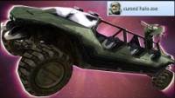
Weapon Physics Demo

Slide 5
Timeline
Create test environment
1
Develop player movement physics (World event and weapon interactions)
2
Create a working environment based around movement
3
Create object physics
4
Create Levels (Tutorial/Easy/
Intermediate/Hard)
5

Slide 6

Questions?

